Slide 1
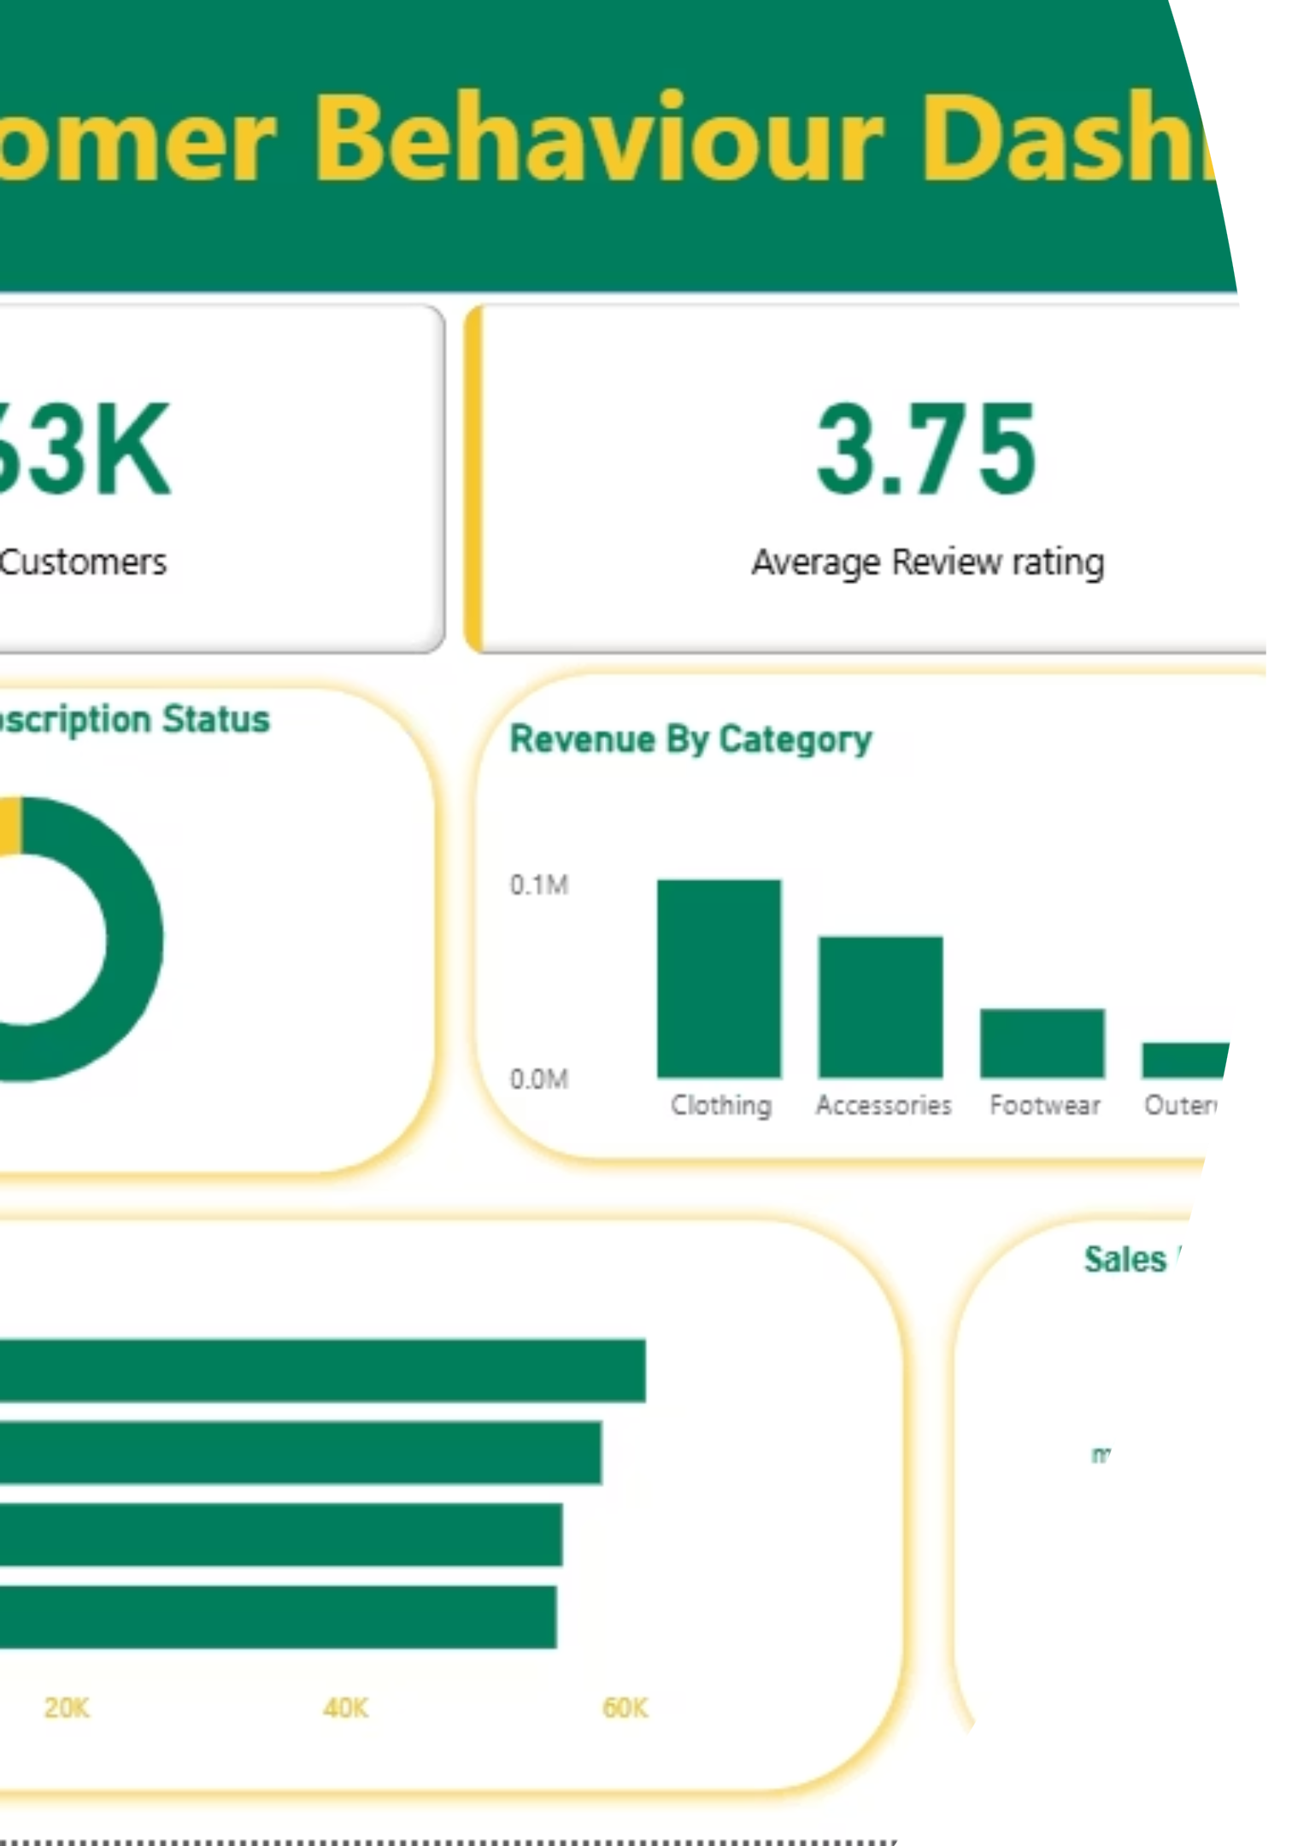
Customer Shopping Behavior Analysis
Uncovering insights from 3,900 purchases to guide strategic business decisions through data-driven analysis of spending patterns, customer segments, and product preferences.

Slide 2

Dataset Overview
3,900 Purchases
18 Columns
Transactional records analyzed across multiple product categories.
Demographics, purchase details, and shopping behavior tracked.
Key Features
Age, gender, location, subscription status, discounts, ratings, and shipping types.

Slide 3

Data Preparation & Cleaning
01
Data Loading
Imported dataset using pandas for Python analysis.
02
Missing Data Handling
Imputed 37 missing Review Rating values using median by product category.
03
Feature Engineering
Created age groups and purchase frequency metrics for deeper insights.
04
Database Integration
Loaded cleaned data into PostgreSQL for SQL analysis.

Slide 4

Revenue Insights by Demographics
Revenue by Gender
Revenue by Age Group
Compared total revenue generated by male versus female customers to identify spending patterns across demographics.
Calculated total revenue contribution of each age group to target high-value customer segments.

Slide 5




Customer Segmentation Strategy
Returning Customers
Repeat purchasers with moderate engagement.
New Customers
First-time buyers entering the customer base.
Loyal Customers
High-frequency buyers with strong brand affinity.

Slide 6
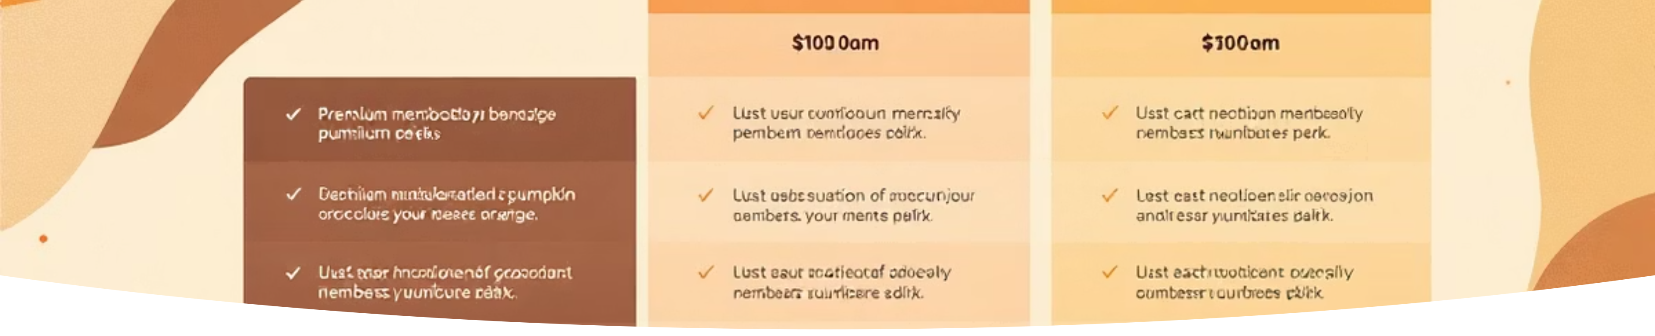
Subscription & Discount Behavior
Subscribers vs. Non-Subscribers
High-Spending Discount Users
Subscribers spend more on average and generate higher total revenue than non-subscribers.
Identified customers using discounts who still spent above average purchase amounts.

Slide 7

Product Performance Analysis
1
Top 5 Products by Rating
Highest average review ratings drive customer satisfaction and repeat purchases.
2
Top 3 Products per Category
Most purchased products within each category reveal category-specific preferences.
3
Discount-Dependent Products
Five products with highest percentage of discounted purchases need margin review.

Slide 8

Shipping & Purchase Patterns
Shipping Type Comparison
Repeat Buyers & Subscriptions
Express shipping users show higher average purchase amounts than standard shipping customers.
Customers with 5+ purchases are significantly more likely to subscribe.

Slide 9
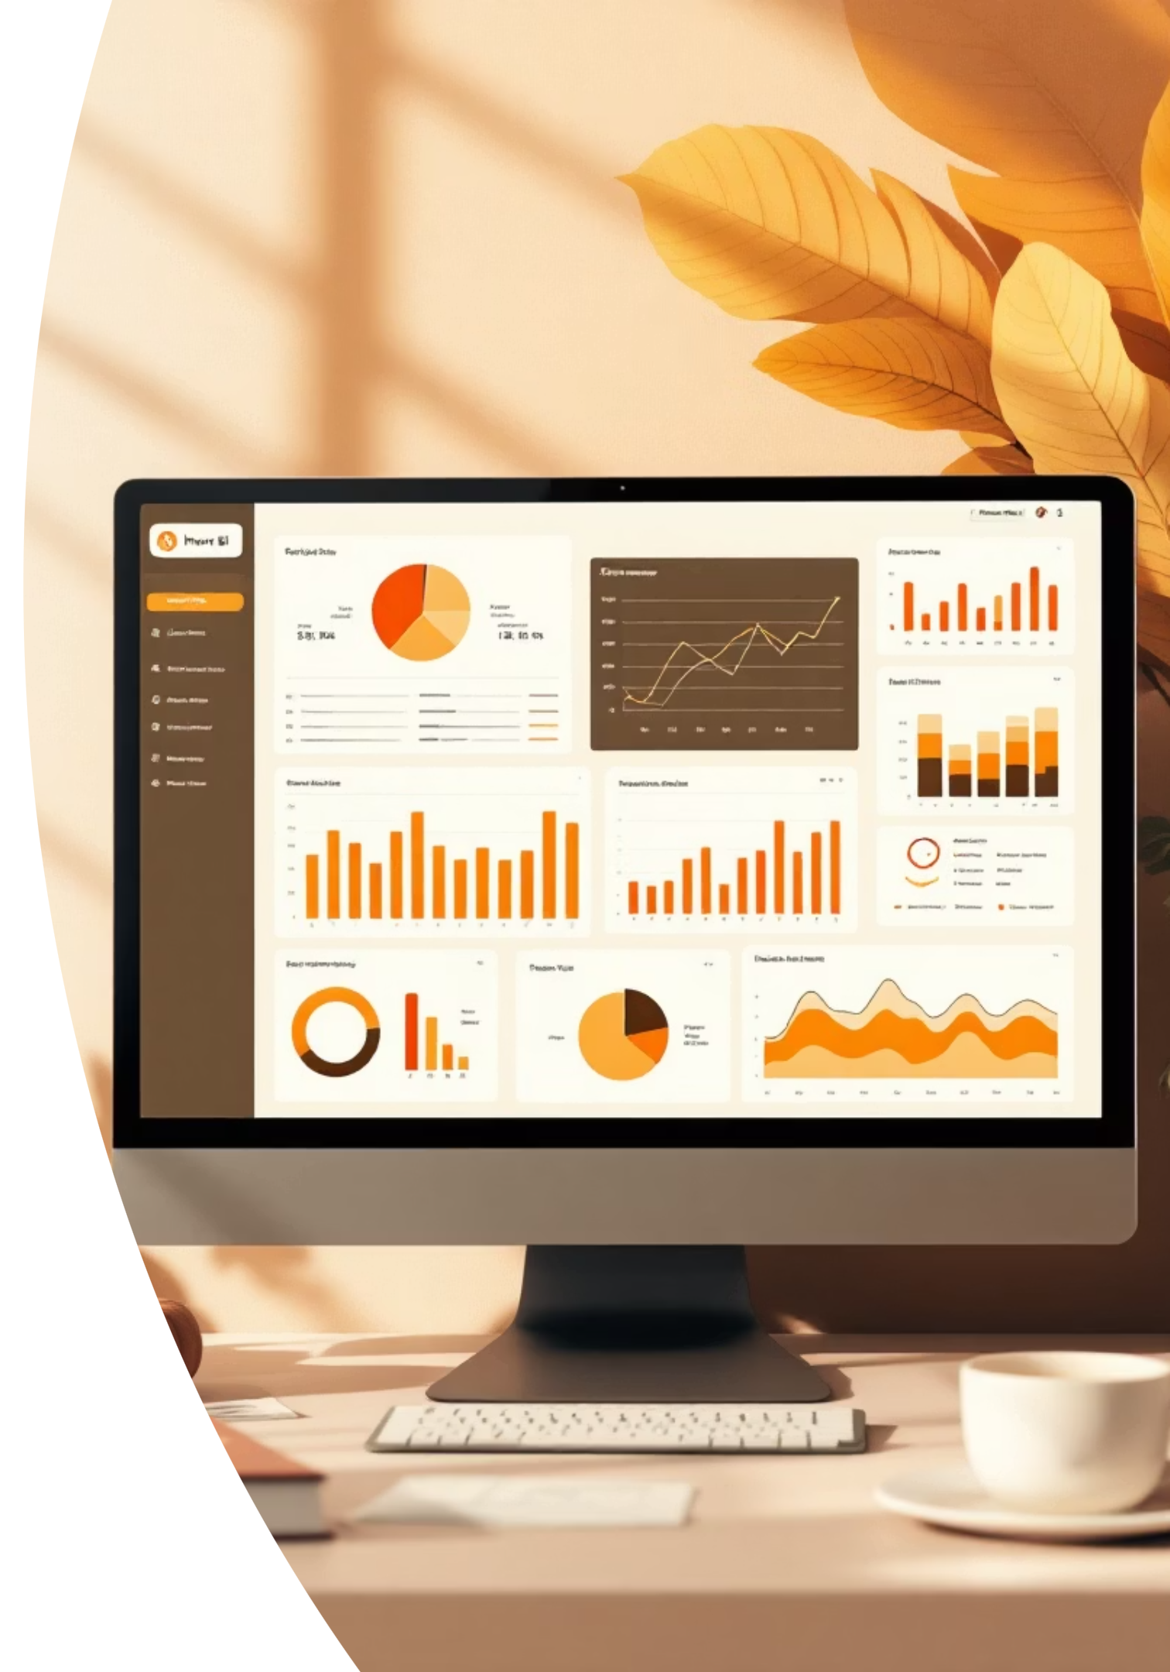
Interactive Power BI Dashboard
Comprehensive visual analytics platform consolidating all insights into actionable business intelligence for real-time decision-making.

Slide 10

Strategic Recommendations
Boost Subscriptions
Promote exclusive benefits to increase subscriber base and revenue.
Loyalty Programs
Reward repeat buyers to move them into the "Loyal" segment.
Review Discount Policy
Balance sales boosts with margin control on discount-dependent products.
Targeted Marketing
Focus on high-revenue age groups and express-shipping users for maximum ROI.

